Slide 1

Chapter 10
Error Detection
and
Correction
10.
Copyright © The McGraw-Hill Companies, Inc. Permission required for reproduction or display.

Slide 2
Error Detection and Correction
Hamming Codes
Cyclic Codes
10.

Slide 3
Hamming Codes
A codeword consists of n bits of which k are data bits and r are parity or check bits.
Hamming codes are a subset of linear block codes that follow two criteria:
Let n = k+r, then we have: n = 2^{r} -1 or
2^{r} ≥ k+r+1
10.

Slide 4
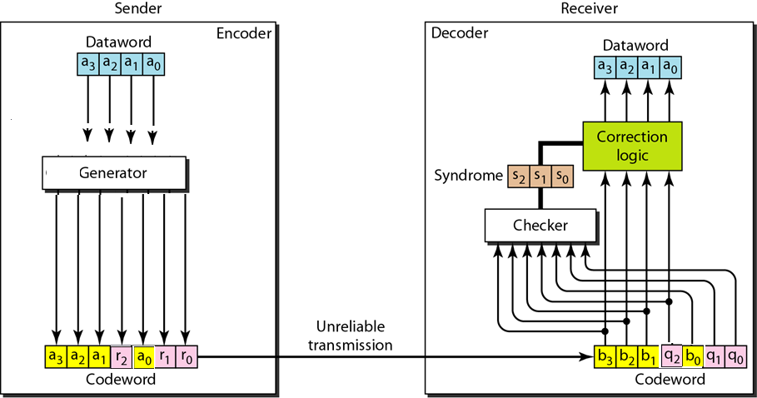
Figure 10.12 The structure of the encoder and decoder for a Hamming code
10.

Slide 5
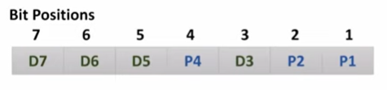
Position of parity bits can be calculated by
P_{n}=2^{n}
where n=0,1,2,3,4…..
Even parity hamming code
Modulo 2 arithmetic or by using XOR (even function
r0 = (a3 + a1 + a0) mod 2 r0 = a3 ⊕ a1 ⊕ a0
r1 = (a3 + a2 + a0 ) mod 2 r1 = a3 ⊕ a2 ⊕ a0
r2 = (a3 + a2 + a1 ) mod 2 r2 = a3 ⊕ a2 ⊕ a1
10.

Slide 6
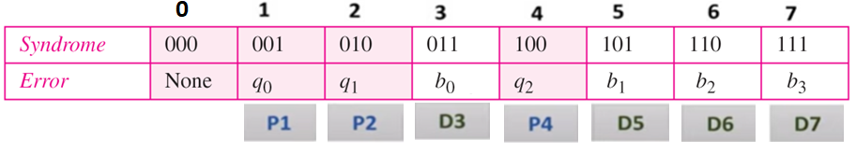
Calculating the syndrome at the receiver:
s0 = (b3 + b1 + b0 + q₀ ) mod 2
s1 = (b3 + b2 + b0 + q₁ ) mod 2
s2 = (b3 + b2+ b1 + q₂ ) mod 2
10.

Slide 7
Example 10.13
Let us trace the path of three datawords from the sender to the destination:
1. The dataword 0100 becomes the codeword 0100011.
The codeword 0100011 is received. The syndrome is
000, the final dataword is 0100.
2. The dataword 0111 becomes the codeword 0111001.
The received codeword is: 0011001. The syndrome is
011. After flipping b₂ (changing the 1 to 0 and 0 to 1),
the final dataword is 0111.
3. The dataword 1101 becomes the codeword 1101000. The
received codeword is: 0001000 (two errors). The
syndrome is 101. After flipping b₀, we get 0000, the
wrong dataword. This shows that our code cannot
correct two errors.
10.

Slide 8
Example 10.14
We need a dataword of at least 7 bits. Calculate values of k and n that satisfy this requirement.
Solution
We need to make k = n − r greater than or equal to 7, or 2^{r} − 1 − r ≥ 7.
1. If we set r = 3, the result is n = 2³ − 1=7 and k = 7 − 3,
or 4, which is < 7.
2. If we set r = 4, then n = 2⁴ − 1 = 15 and k = 15 − 4 =
11, which satisfies the condition k>7. So the code is
C(15, 11)
10.

Slide 9
CYCLIC CODES
In a cyclic code, if a codeword is cyclically shifted (rotated), the result is another codeword. For example, if 1011000is a codeword and we cyclically left-shift, then 0110001is also a codeword. In this case, if we call the bits in the first word a0 to a6, and the bits in the second word b0 to b6, we can shift the bits by using the following:
b1= a0
b2= a1
b3= a2
b4= a3
b5= a4
b6= a5
b0= a6
10.

Slide 10
Cyclic Redundancy Check (CRC)
The dataword has k bits
The codeword has n bits
The size of the dataword is augmented by adding n − k 0s to the right-hand side of the word.
The n-bit result is fed into the generator. The generator uses a divisor of size n − k + 1.
The generator divides the augmented dataword by the divisor (modulo-2 division).
The quotient of the division is discarded; the remainder (r2r1r0) is appended to the dataword to create the codeword.
10.

Slide 11

Table 10.6 A CRC code with C(7, 4)
10.

Slide 12

Figure 10.14 CRC encoder and decoder
10.

Slide 13

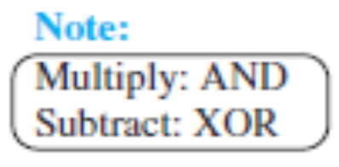
Figure 10.15 Division in CRC encoder
10.

Slide 14

Figure 10.16 Division in the CRC decoder for two cases
10.

Slide 15
Using Polynomials
We can use a polynomial to represent a binary word.
Each bit from right to left is mapped onto a power term.
The rightmost bit represents the “0” power term. The bit next to it the “1” power term, etc.
If the bit is of value zero, the power term is deleted from the expression.

Slide 16

Figure 10.21 A polynomial to represent a binary word
10.

Slide 17

Figure 10.22 CRC division using polynomials
10.

